Slide 1
Distributed Systems
Distributed Objects & Remote Invocation
Dr. Sunny Jeong. spjeong@uic.edu.hk
Mr. Bill Junru ZHONG billjrzhong@uic.edu.hk
With Thanks to Prof. G. Coulouris, Mr. David Matuszek and Prof. S.C Joo

Slide 2



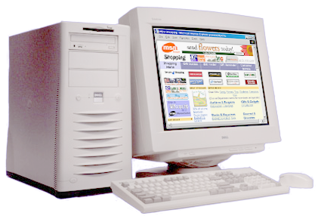



Distributed Object & Remote invocation
Request
Reply
Local Data Format
Marshalling
Unmarshalling
Local Data Format
Network
% rmic 클래스명
Laptop
Unmarshalling
Marshalling
Global Data Format
(ex, XDR, CDR, Java object serialization )
desktop
PDA

Slide 3
Overviews
Distributed applications programming
  distributed objects model(object-oriented model)
  RMI invocation semantics(object-based model)
  RPC(conventional procedure call model)
  events and notifications(event-based programming model)
Products
  Java RMI, CORBA, DCOM
  Sun RPC
  Jini( distributed event notification specification by Arnold K. – JVM)

Slide 4
Why Middleware?
Location transparency
  Client/server need not know their location
Sits on top of OS, independent of:
  communication protocols: use abstract request-reply protocols over UDP, TCP
  computer hardware: use external data representation e.g. CORBA CDR
  operating system : use e.g. socket abstraction available in most systems
  programming language:. CORBA supports Java, C++ etc.
Applications
RMI, RPC and events
Request reply protocol
Middleware
External data representation
layers
Operating System

Slide 5
Objects
object
object
Object = data + methods
  logical and physical nearness
  first class, can be passed as arguments
Interact via interfaces:
  define types of arguments and exceptions
  of methods
IDL(Interface Definition Language)
  define interfaces between objects implemented in different languages
  CORBA IDR- IDL for RMI, Sun XDR-IDL for RPC, WSDL-for internet-wide RPC, DCE-IDL, DCOM-IDL)
Data
interface
Data
m1
m4
implementation
m2
m5
implementation
of methods
m3
of methods

Slide 6
Communication between Distributed Objects [by RMI]
The object model
  the relevant aspects of the object model
Distributed objects
  a presentation of object-based distributed system
The distributed object model
  extensions to the object model for supporting distributed objects
Design issues
  Local (method) invocation, RMI(Remote method Invocation)
Implementation
  middleware, RMI(request-reply protocol)
Distributed garbage collection
  algorithm using RMI implementation

Slide 7
The object model
Programs logically partitioned into objects
  distributing objects are natural and easy
  distributed objects are server objects and client objects,
  client objects invoke server objects’ methods using (local, remote) method invocation
Object reference
  unique identifier used for accessing an object
Interfaces
  definition of the signature of a set of methods
  the only means to access data, make remote objects connected
Actions
  executing via method invocation, interaction, and chains of invocations
  may lead to exceptions, part of interface
Garbage collection
  reduced effort, error-free (Java, not support C++)
32 bits
32 bits
32 bits
32 bits
Internet address
port number
time
object number
interface of
remote object

Slide 8
The distributed object model ← the object model
Objects distributed (by client-server model)
This distributed object model model extends with
  Remote object reference
  Remote interfaces
  Remote Method Invocation (RMI)
remote
local
C
invocation
invocation
local
E
invocation
remote
instantiate
B
invocation
F
A
local
invocation
D
Object instantiation
remote
object
Data
remote
{
m1
Implementation
m4
m2
m5
interface
m3
of methods
m6

Slide 9
Advantages of distributed objects
Data encapsulation gives better protection
  concurrent processes, interference
Method invocations
  can be remote or local invocations
Objects
  can act as clients, or servers, etc
  can be replicated for fault-tolerance and performance
  can migrate, be cached for faster access

Slide 10
Remote object reference
Object references
  used to access objects which live in processes
  can be passed as arguments(results), stored in variables,...
Remote object references
  object identifiers in a distributed system
  must be unique in space and time
  error returned if accessing a deleted object
  can allow relocation

Slide 11
Remote object reference -ctd
Constructing unique remote object reference
  IP address, port, interface name
  time of creation, local object number (new for each object)
Use the same as for local object references
If used as addresses
  cannot support relocation (alternative in CORBA)
32 bits | 32 bits | 32 bits | 32 bits | 32 bits
Internet address | port number | time | object number | interface of remote object

Slide 12
Remote interfaces
Specify externally accessed
  variables and procedures
  no direct references to variables (no global memory)
  local interface separate(that is, remote interface)
Parameters
  input, output or both,
  instead of call by value, use call by reference
No pointers
No constructors

Slide 13
Remote object and its interfaces
CORBA: Interface Definition Language (IDL)
Java RMI: as other interfaces, keyword Remote http://docs.oracle.com/javase/8/docs/api/
remote
object
remote
Data
interface
m4
{
m1
implementation
m2
m5
m3
of methods
m6

Slide 14
Handling remote objects
Exceptions
  raised in remote invocation
  clients need to handle exceptions
  timeouts in case server crashed or too busy
Garbage collection
  distributed garbage collection may be necessary
  combined local and distributed collector
  cf. Java reference counting

Slide 15
RMI issues
Request
Reply
Local invocations
  executed exactly once( = one time invocation)
Remote invocations
  via Request-Reply protocol
  may suffer from communication failures!
    retransmission of request/reply
    message duplication, duplication filtering
  no unique semantic.
Main choices for delivery guarantees
  Retry request message(retransmission of request message)
  Duplicate filtering(filter out duplicate requests at server)
  Retransmission of results(without re-executing the operation at server)
Client
Server
doOperation
Request
message
getRequest
Select object
(wait)
Execute method
Reply
message
sendReply
(continuation)

Slide 16
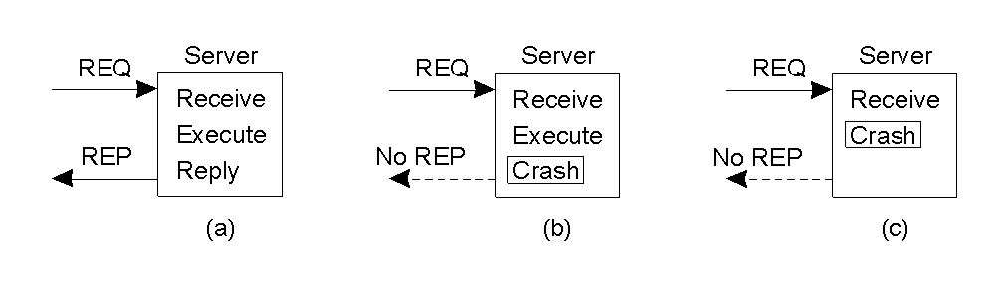
Message Lost
Communication Crashes : lost Request/Reply Messages
Client Crashes : Orphan
Server Crashes
Types of Failure
Type of failure | Descriptions
Crash failure | A server halts, but is working correctly until it halts
Omission failure Receive omission Send omission | A server fails to respond to incoming requests A server fails to receive incoming messages A server fails to send messages
Timing failure | A server's response lies outside the specified time interval
Response failure Value failure State transition failure | The server's response is incorrect The value of the response is wrong The server deviates from the correct flow of control
Arbitrary failure | A server may produce arbitrary responses at arbitrary times

Slide 17
Maybe invocation(= Maybe call semantic)
Remote method
  may execute or not at all, invoker cannot tell
  useful only if occasional failures
Invocation message lost...
  method not executed
Result not received...
  was method executed or not?
Server crash...
  before or after method executed?
  if timeout, result could be received after timeout...
Request
Reply

Slide 18
At-least-once invocation
Remote method
  invoker receives result (executed exactly) or exception (no result, executed once or not at all)
  retransmission of request messages without duplicate filtering
Invocation message retransmitted...
  method may be executed more than once
  arbitrary failure (wrong result possible)
  method must be idempotent (repeated execution has the same effect as a single execution)
Server crash...
  dealt with by timeouts, exceptions
Used by SUN-RPC
Request
Reply

Slide 19
At-most-once invocation
Remote method
  invoker receives result (executed exactly once) or exception (no result)
  retransmission of reply & request messages
  duplicate filtering
Using best fault-tolerance measures
  arbitrary failures prevented if method called at most once
Used by CORBA and Java RMI
Request
Reply

Slide 20
Transparency of RMI
Should remote method invocation be same as local (method)?
  same syntax, see Java RMI (keyword Remote)
  need to hide
    data marshalling
    IPC calls
    locating/contacting remote objects
Problems
  different RMI semantics? susceptibility to failures?
  protection against interference in concurrent scenario?
Approaches (Java RMI)
  transparent, but express differences in interfaces
  provide recovery features

Slide 21
Implementation of RMI
Object A invokes a method in a remote object B:
Modules
  Communication module, Remote reference module, RMI software[
  generation of classes(Proxies, Dispatcher, Skeleton)], Client & Server Program.
A
B
client
server
skeleton
remote
object A
proxy for B
& dispatcher
object B
Request
for B’s class
Reply
Remote
Communication
Communication
Remote reference
reference module
module
module
module

Slide 22
Communication modules
Reside in client and server
Carry out Request-Reply jointly
  use unique message Ids (new integer for each message)
  implement given RMI semantics
Server’s communication module
  selects dispatcher within RMI software
  converts remote object reference to local object reference

Slide 23
Remote reference module
Creates remote object references and Proxies
Translates remote (reference) to local references (object table)
  correspondence between remote and local object references (proxies )
Directs requests to proxy (if exists)
Called by RMI software
  when marshalling/unmarshalling

Slide 24
JAVA RMI
  Definition
    RMI (Remote Method Invocation) allows a Java program to invoke a method that is being executed on a remote machine
  Character
    Transparency Method call
    Support Callback from Server to Client
  Action
    Stub and Skeleton
      Class allow exchanging data between Client and Server
    Remote Reference layer
      Support various hosts in heterogeneous environment
    Transport layer
      Path the marshaled stream
Client
Server
Stub
Skeleton
Remote Reference Layer
Transport Layer

Slide 25
What is needed for RMI
Java makes RMI (Remote Method Invocation) fairly easy, but there are some extra steps
To send a message to a remote “server object,”
  The “client object” has to find the object
    Do this by looking it up in a registry
  The client object then has to marshal the parameters (prepare them for transmission)
    Java requires Serializable parameters
    The server object has to unmarshal its parameters, do its computation, and marshal its response
  The client object has to unmarshal the response
Much of this is done for you by special software

Slide 26
Terminology
A remote object is an object on another computer
The client object is the object making the request (sending a message to the other object)
The server object is the object receiving the request
As usual, “client” and “server” can easily trade roles (each can make requests of the other)
The rmiregistry is a special server that looks up objects by name
  Hopefully, the name is unique!
rmic is a special compiler for creating stub (client) and skeleton (server) classes

Slide 27
Processes
For RMI, you need to be running three processes
  The Client
  The Server
  The Object Registry, rmiregistry, which is like a DNS service for objects
Also need TCP/IP active

Slide 28
Interfaces
Interfaces define behavior
Classes define implementation
Therefore,
  In order to use a remote object, the client must know its behavior (interface), but does not need to know its implementation (class)
  In order to provide an object, the server must know both its interface (behavior) and its class (implementation)
In short,
  The interface must be available to both client and server
  The class should only be on the server

Slide 29
Classes
A Remote class is one whose instances can be accessed remotely
  On the computer where it is defined, instances of this class can be accessed just like any other object
  On other computers, the remote object can be accessed via object handles
A Serializable class is one whose instances can be marshaled (turned into a linear sequence of bits)
  Serializable objects can be transmitted from one computer to another
It probably isn’t a good idea for an object to be both remote and serializable

Slide 30
Conditions for serializability
If an object is to be serialized:
  The class must be declared as public
  The class must implement Serializable
  The class must have a no-argument constructor
  All fields of the class must be serializable: either primitive types or serializable objects

Slide 31
Remote interfaces and class
A Remote class has two parts:
  The interface (used by both client and server):
    Must be public
    Must extend the interface java.rmi.Remote
    Every method in the interface must declare that it throws java.rmi.RemoteException (other exceptions may also be thrown)
  The class itself (used only by the server):
    Must implement a Remote interface
    Should extend java.rmi.server.UnicastRemoteObject
    May have locally accessible methods that are not in its Remote interface

Slide 32
Remote vs. Serializable
A Remote object lives on another computer (such as the Server)
  You can send messages to a Remote object and get responses back from the object
  All you need to know about the Remote object is its interface
  Remote objects don’t pose much of a security issue
You can transmit a copy of a Serializable object between computers
  The receiving object needs to know how the object is implemented; it needs the class as well as the interface
  There is a way to transmit the class definition
  Accepting classes does pose a security issue

Slide 33
Security
It isn’t safe for the client to use somebody else’s code on some random server
  Your client program should use a more conservative security manager than the default
Most discussions of RMI assume you should do this on both the client and the server
  Unless your server also acts as a client, it isn’t really necessary on the server

Slide 34
The server class
The class that defines the server object should extend UnicastRemoteObject
  This makes a connection with exactly one other computer
  If you must extend some other class, you can use exportObject() instead
  Sun does not provide a MulticastRemoteObject class
The server class needs to register its server object:
  String url = "rmi://" + host + ":" + port + "/" + objectName;
    The default port is 1099
  Naming.rebind(url, object);
Every remotely available method must throw a RemoteException (because connections can fail)
Every remotely available method should be synchronized

Slide 35
Hello world server: interface
import java.rmi.*;
public interface HelloInterface extends Remote {
public String say() throws RemoteException;
}

Slide 36
Hello world server: class
import java.rmi.*;
import java.rmi.server.*;
public class Hello extends UnicastRemoteObject
implements HelloInterface {
private String message; // Strings are serializable
public Hello (String msg) throws RemoteException {
message = msg;
}
public String say() throws RemoteException {
return message;
}
}

Slide 37
Registering the hello world server
class HelloServer {
public static void main (String[] argv) {
try {
Naming.rebind("rmi://localhost/HelloServer",
new Hello("Hello, world!"));
System.out.println("Hello Server is ready.");
}
catch (Exception e) {
System.out.println("Hello Server failed: " + e);
}
}
}

Slide 38
The hello world client program
class HelloClient {
public static void main (String[] args) {
HelloInterface hello;
String name = "rmi://localhost/HelloServer";
try {
hello = (HelloInterface)Naming.lookup(name);
System.out.println(hello.say());
}
catch (Exception e) {
System.out.println("HelloClient exception: " + e);
}
}
}

Slide 39
rmic
The class that implements the remote object should be compiled as usual
Then, it should be compiled with rmic:
  rmic Hello
This will generate files Hello_Stub.class and Hello_Skel.class
These classes do the actual communication
  The “Stub” class must be copied to the client area
  The “Skel” was needed in SDK 1.1 but is no longer necessary

Slide 40
Trying RMI
In three different terminal windows:
  Run the registry program:
    rmiregistry
  Run the server program:
    java HelloServer
  Run the client program:
    java HelloClient
If all goes well, you should get the “Hello, World!” message

Slide 41
JAVA RMI
RMI Tools
Tool | Description
rmic | Generate stubs and skeletons for remote objects
rmiregistry | Remote object registry service
rmid | RMI activation system daemon
serialver | Return class serialVersionUID

Slide 42
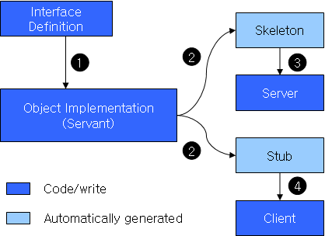

RMI Program Procedure
Set a remote interface
Remote interface class
Complete server program
Set a client program to use the remote object
Compile ②,③,④
Create stub and skeleton by rmic
Activate rmiregistry
Run the programs
% rmic Classname

